Slide 1


Overview, use cases and case studies on the Telco Score API
API OVERVIEW
Telefónica Open Gateway
8 May 2024

Slide 2
TELEFÓNICA OPEN GATEWAY / API TELCO SCORE
Table of Contents
01.
Overview
02.
Use Cases

Slide 3
01
Overview

Slide 4


Overview
TELEFÓNICA OPEN GATEWAY / API TELCO SCORE
What is?
Benefits
OpenGateway’s Telco Score complements financial institutions' credit scores with a user score designed to evaluate an individual's eligibility and financial telco capability.
It is generated by telcos utilizing the vast array of data analytics capabilities inherent in telecom big data.
Financial Institutions Expansion:
Banks, card companies, and micro-lenders can expand their customer base with a reduced risk of default.
It provides access to credit for unbanked users:
Previously excluded individuals can gain better access to essential credit services, such as loans.
Enhanced Conversion rates:
Non-financial companies can utilize the Telco Score to identify customers with a good reputation and simplify the onboarding process for these users.

Slide 5



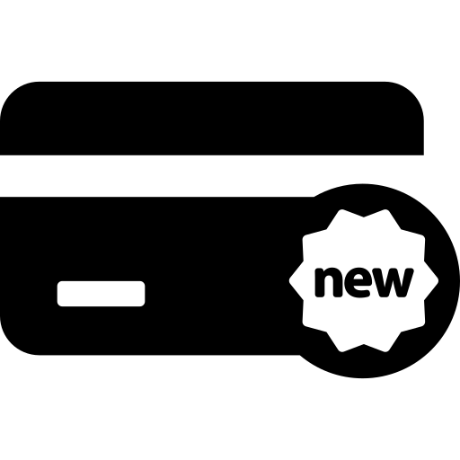


Traditional credit score calculation models of financial entities are largely based on credit history data, which greatly disadvantages new entrants.
TELEFÓNICA OPEN GATEWAY / API TELCO SCORE
HOW CREDIT SCORE IS CALCULATED
LIMITATIONS
Financial Inclusion: Traditional credit scoring models can disadvantage individuals with limited credit histories.
Payment history (35%)
Total debt owned (30%)
Rigid Criteria: Credit worthiness is determined by a rigid set of criteria, rather than a comprehensive assessment of an individual’s behaviour.
CREDIT SCORE
Parametric Limitations: Parametric models like linear probability and logit models have structural limitations in capturing complex non-linear relationships in risk data.
New credit (10%)
Length of credit history (15%)
Types of credit (10%)

Slide 6






Overview
TELEFÓNICA OPEN GATEWAY / API TELCO SCORE
Characteristics of Telco Score
Financial Inclusion
Improves risk decisions
Privacy by design
Telecom data provides financial identity to those without traditional banking history.
It enables companies to optimize service offerings. Combined with proprietary data insights, it refines customer segmentation.
The system is fundamentally built with the privacy of the individual's data as a core component. From the moment data is collected to the processing and storage of information, privacy would be an intrinsic part of the entire lifecycle.

Slide 7
02
Use cases

Slide 8

Overview / Use Cases
TELEFÓNICA OPEN GATEWAY / API TELCO SCORE
Credit Application Evaluation
This use case involves utilizing telco scoring to improve credit decision-making for individuals without traditional banking histories, particularly in regions with high rates of unbanked populations.
OTHER RELATED APIs
SECTOR
SERVICE | PAYMENTS
CUSTOMER NEEDS
FINANCIAL SERVICES & INSURANCE
Facilitates financial inclusion by assessing creditworthiness of individuals without traditional banking history.
Enables lenders to extend credit to unbanked populations, promoting economic empowerment and growth in communities.
Utilizes alternative telecom score to provide financial identity and access to credit for previously underserved individuals.
API KYC

Slide 9

Overview / Use Cases
TELEFÓNICA OPEN GATEWAY / API TELCO SCORE
Telco Score in onboarding of new clients
By utilizing telco score, companies can significantly streamline their customer onboarding processes. This approach involves integrating telco scoring as a reliable assessment tool to evaluate the creditworthiness and risk associated with new clients quickly. By relying on telco scoring, companies can reduce or eliminate additional verification steps typically required during the onboarding process. This not only speeds up the process but also improves conversion rates as potential customers face fewer hurdles to entry. The use of credit scores helps ensure that the company maintains a balance between efficient client intake and risk management.
OTHER RELATED APIs
SECTOR
SERVICE | PAYMENTS
CUSTOMER NEEDS
MEDIA, ENTERTAINMENT & XR
Reduced Fraud Risk: Telco Scorehelps mitigate the risk of fraudulent registrations, spam accounts, and malicious activities, safeguarding the integrity of the platform and protecting users' interests.
Improved Conversion Rates: By providing an additional layer of security, Telco Score can streamline the registration process and increase user confidence, resulting in higher conversion rates and a more positive user experience.
API KYC

Slide 10

Use case: Personalization of Advertising Campaigns
TELEFÓNICA OPEN GATEWAY / API TELCO SCORE
Opportunity
In the competitive landscape of online retail, understanding customer behaviour and mitigating risks is essential for success. By integrating the Telco Score API into their online sales strategies, e-commerce businesses can gain insights into customer profiles, enabling personalized product campaigns tailored to different segments.
Use Case Scenario:
Consider an e-commerce platform specializing in luxury fashion items. To optimize its marketing efforts and minimize risks associated with fraudulent transactions, the platform integrates the Telco Score API into its sales platform.
OTHER RELATED APIs
SECTOR
SERVICE |  | ADVERTISEMENT
CUSTOMER NEEDS
API KYC
RETAIL
Cost Efficiency: Targeting advertising spend towards high-potential segments reduces wasted resources and improves overall campaign ROI.
Improved Conversion Rates: By catering to the specific needs and preferences of each risk segment
elevant Recommendations: Personalized advertisements based on their preferences and behavior, leading to a more enjoyable and relevant browsing experience.

Slide 11




